Slide 1

Chainsmith
Automatically Learning the Semantics of Malicious Campaigns by Mining Threat Intelligence Reports
Zhu et al., 2008 IEEE European Symposium on Security and Privacy

Slide 2

Introduction

Slide 3

What is Threat Intelligence?
- Refers to the gathering and analysis of information about security threats.
- Sharing the technical details makes everyone safer as attackers cannot reuse their tactics.
Contributions made by this paper:
Design of ChainSmith, an IOC extraction system.
Evaluation of the effect of different persuasion techniques used by attackers.
Setting up of a WebApp to release the latest data from ChainSmith to further stimulate Threat Intelligence.

Slide 4

Problem Statement

Slide 5

Problem Statement
Threat intelligence reflects a careful manual analysis of security threats, with conclusions from experts.
These conclusions are encoded in Indicators of Compromise (IOCs), which is some observable entity.
Security tools based on IOC may not always provide adequate defense.
Novel Approach
An attempt to link measurement data to threat intelligence.
This gives new insights about attacker strategies from the measurement data and analysis about the impact of attacks.

Slide 6



Use Case
Malware delivery
Neither threat intelligence nor measurement techniques can provide a complete picture of malware delivery campaigns.
These insights require connecting both.
Goals
Extraction of threat intelligence in a manner that complements measurement data.
Extraction of both IOCs and their roles in an attack.
Examining the usefulness of threat intelligence.

Slide 7
Malware Delivery Model
Cyber attacks usually follow certain patterns:
The STIX schema defines a ‘campaign’ to be a set of ‘indicators’, which are a set of ‘observables.
‘Observables are like IOCs, and are of 88 different types, including URL, IP address, etc.
The stages selected from the STIX data model for this paper are:
1. Baiting
Email spam, malvertising and compromised sites.
2. Exploitation
The exploit server tries to identify vulnerabilities to deliver the payload
3. Installation
A malicious payload is downloaded and installed to execute the malware.
(This step may happen without step 2 occurring before it too.)
4. Command and Control
The malware contacts its command and control server and receives instructions to perform malicious acts.

Slide 8
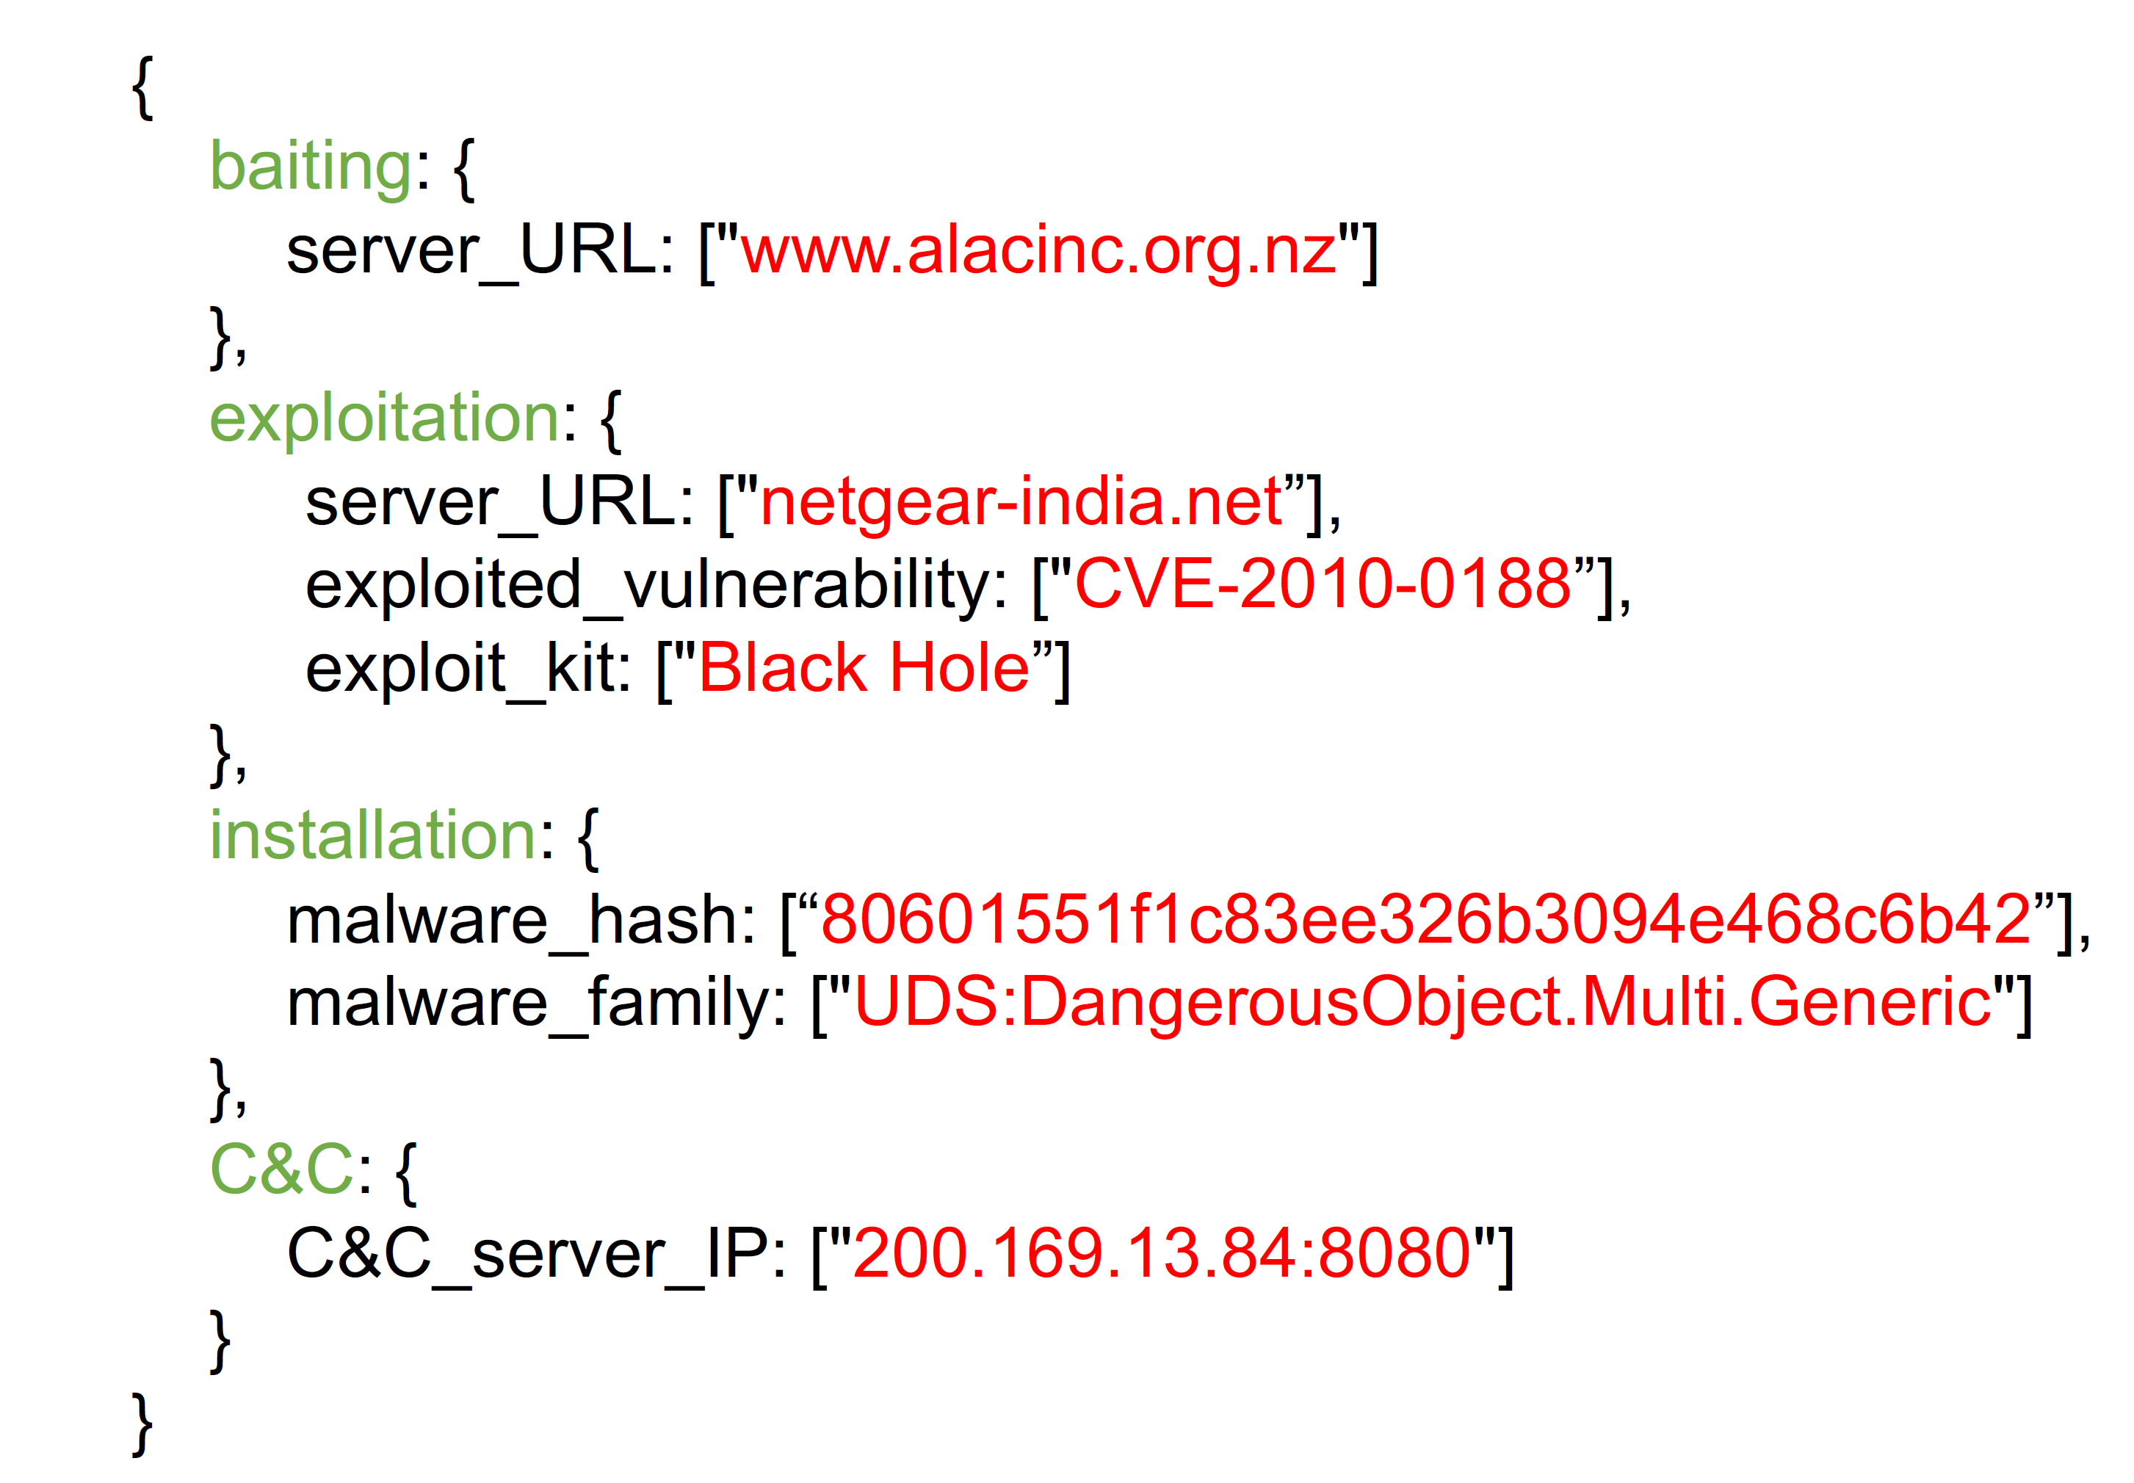

Slide 9
Threats to Validity
Malware may not be detected as soon as it is released into the wild.
Threat intelligence reports may be incorrect.
Data Set
Data collected using Symantec’s WINE platform.
This data is not entirely complete, as it does not observe long running campaigns.
This data is utilised to demonstrate how ChainSmith can fill the gaps in measurement data with threat intelligence.

Slide 10
Experimental Methods

Slide 11
Article Crawler
A generic crawler is implemented to collect security articles online.
This helps to gain a full picture of an end-to-end campaign.
The sources are made to be very diverse.
Expression Detector
Security narratives often include muti-word expressions.
Such expressions are identified using a method proposed by Mikolov et al.
Syntactic Parser
This performs tokenizing and dependency parsing, which converts the string into a tree structure to represent word dependency.
Python NLTK and Stanford CoreNLP are used.

Slide 12
Semantic Parser
To consider the meaning of the words too, semantic parsing is done using word2vec.
The words with close semantic meaning will be represented in a close position in vector space.
Named Entity Recognition
Regular expressions are used to identify candidate IOCs
IOC Classifier
Goal is to identify whether a word is an IOC, and the stage of the campaign it belongs to.
The classifier considers features both at the dependency tree and sentence levels.
For each sentence, we look at context from three sources:
Informative words from the current sentence.
Informative words from the previous sentence.
Informative words from the previous sentence that mention the same IOC

Slide 13
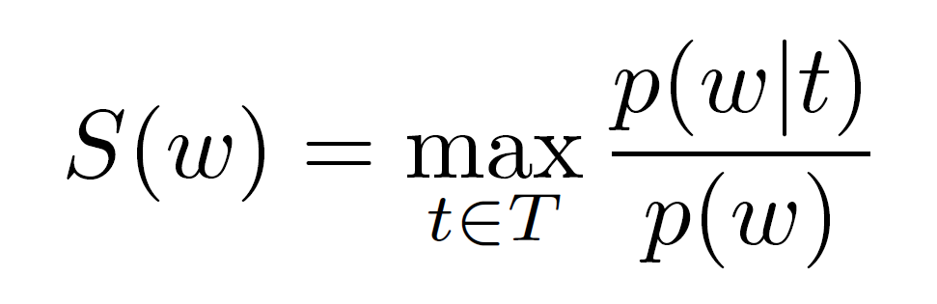
IOC Classifier (Contd.)
First, we need to identify informative words.
The following equation is used:
where,
T is the set of malware campaign phases
w is the word we evaluated
p(w) is the probability of word w
p(w) is the probability that word w will be used for describing topic t.

Slide 14
IOC Classifier (Contd.)
Features used to identify the sentence topic:
Average word embedding of the context words.
Average word embedding of the article title.
Number of IOCs of each type.
Four binary classifiers are trained to identify topic probabilities. The classifier is implemented using neural network with one hidden layer and fifty hidden nodes.
To verify that the named entities identified represent IOCs of some campaign, a multi-class classifier for each class type is trained, which contains:
The probability of each topic.
Average dependency embedding for all dependencies connected to the named entity.
Type specific features (URL and IP only)

Slide 15
Campaign Group Identification
We assume that each technical article discusses one supplier and multiple consumers.
For each articles, all the IOCs in the baiting and exploitation phase are grouped as one and all the other IOCs go to separate groups.
If two campaigns contain identical IOCs and appear within a short time frame of each other, then we consider them to be a part of the same campaign.
Threshold: 6 months

Slide 16
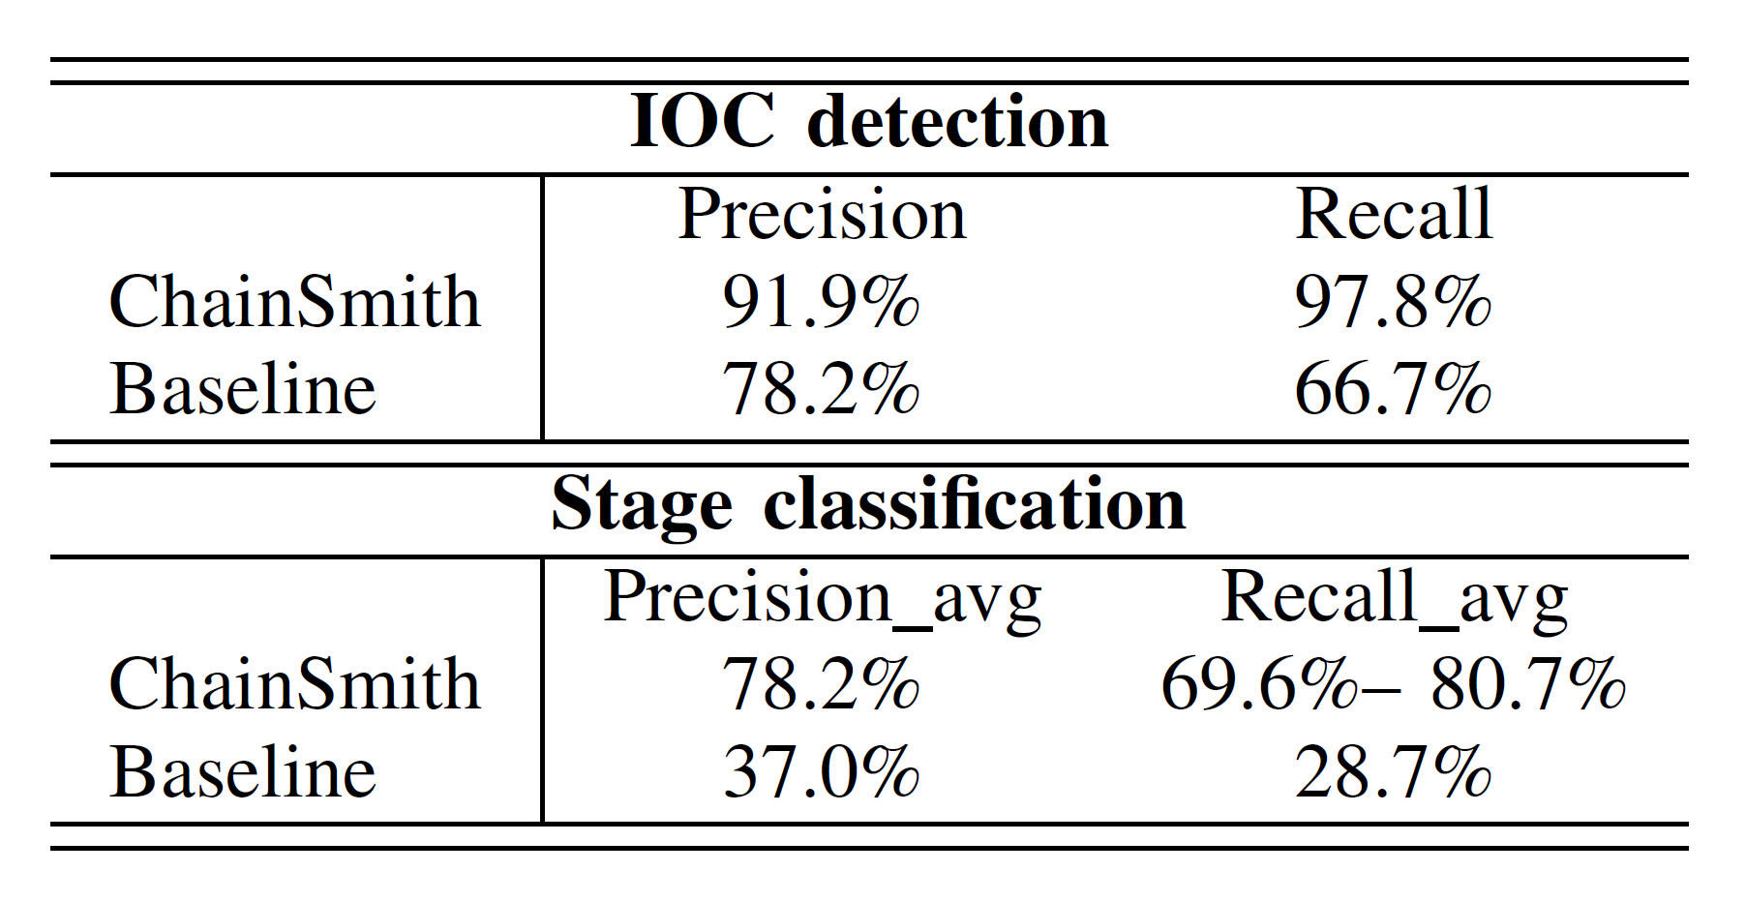
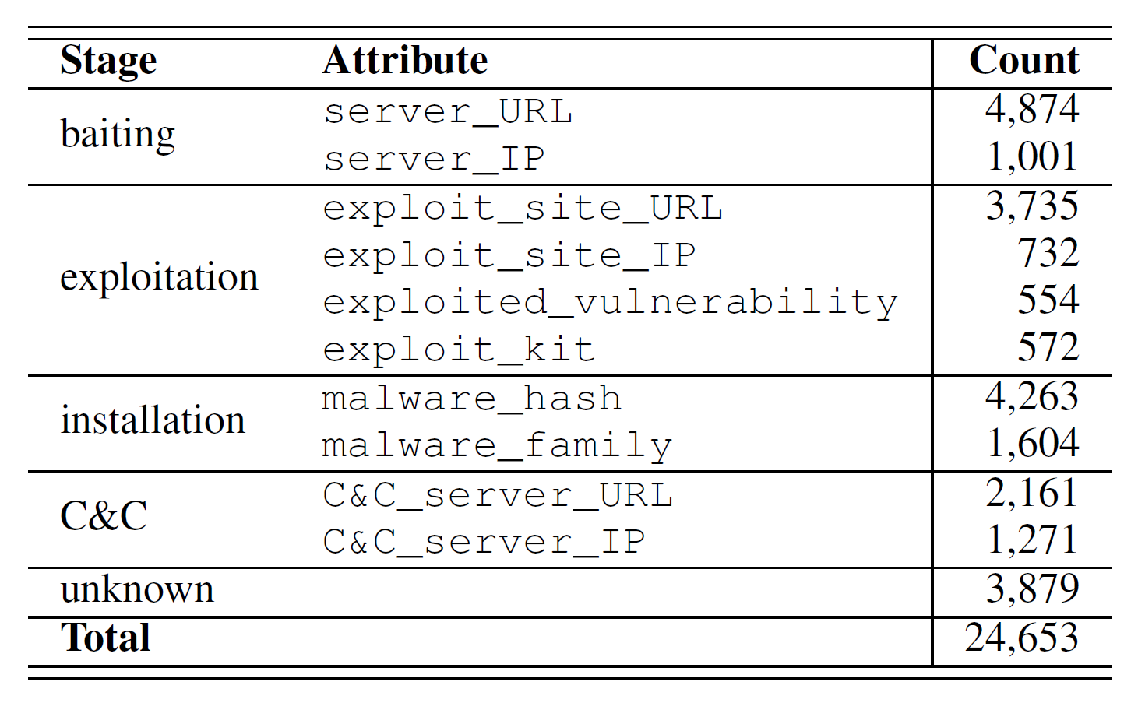
Performance
Baseline uses traditional topic modelling.
Summary of extracted IOCs

Slide 17
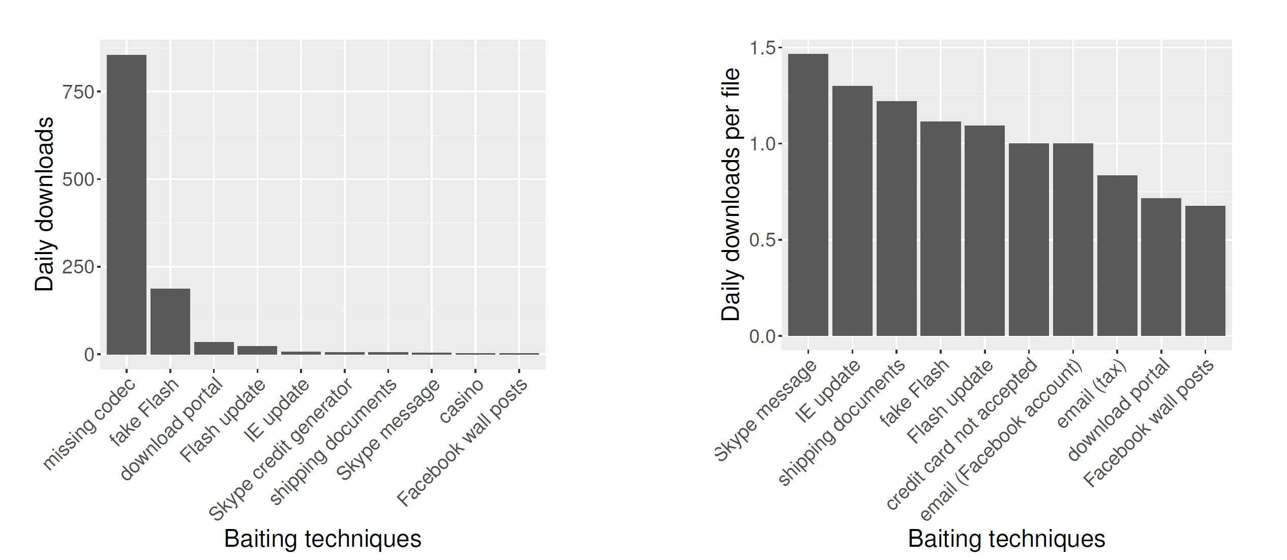
Persuasion Techniques
Attackers design creative persuasion methods.
Social engineering does not involve exploitation and intrusion, and happens with the consent of the victim.
Eg: Download a ‘missing plugin’ to play an online video.

Slide 18
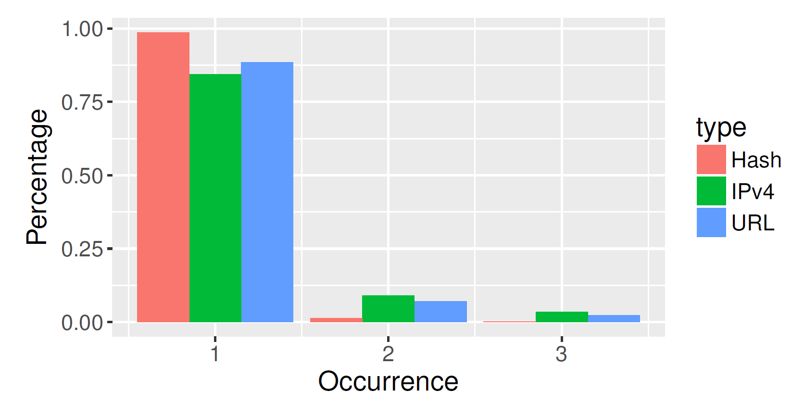
Lifecycles of campaigns and infrastructure
Most campaign groups use social engineering for delivery.
Most of the domains used in exploitation and intrusion may change frequently and hence it is difficult to use IOCs for long-running campaigns.
This has important implications for threat intelligence.
However, domains may still be useful as attackers may reuse some of their infrastructure.
Attackers may also reuse an old domain/IP once it is off the blacklists.

Slide 19
Discussion
Persuasion Techniques
Users are enticed through social engineering.
No malicious behaviour while downloading, hence harder to detect.
These campaigns are usually long-running
Can be detected by the language of the malvertisements.
Campaign Detection
The focus has traditionally been on malicious behaviour, and not unexpected behaviour.
The easiest way out is to block the malvertisements.
Threat Intelligence
Threat intelligence makes it possible for the security researchers to explain the measurement data.
It is extremely useful to club threat intelligence with measurement data.
Relationships among IOCs is another useful tool.

Slide 20
Conclusion
ChainSmith automatically extracts IOCs from articles/reports and classifies them into different campaign stages.
This makes is possible to combine threat intelligence with field-gathered data.
ChainSmith achieves 91.9% precision and 97.8% recall for extracting IOCs from natural language documents.
It was found that most campaigns deliver payloads through social engineering.
Media player advertising – ‘missing codec’ – is the most persuasive and potent.
Finally, some light is shed on the use cases for leveraging IOCs in security forensics.

Slide 21

Zhu, Ziyun, and Tudor Dumitras. "Chainsmith: Automatically learning the semantics of malicious campaigns by mining threat intelligence reports." 2018 IEEE European Symposium on Security and Privacy (EuroS&P). IEEE, 2018.

Slide 22


Thank You.
Kabir Kanha Arora
ka682@snu.edu.in

